Slide 1
Motivation and Emotion
?
Interactive Topic Test
rcg

Slide 2
1
2
3
4
5
100
100
100
100
100
200
200
200
200
200
300
300
300
300
300
400
400
400
400
400
500
500
500
500
500

Slide 3
1 for 100
_________ : the process by which activities are started, directed, and continued so that physical or psychological needs or wants are met.
What is Motivation?

Slide 4
1 for 200
Need for achievement (nAch): involves a strong desire to succeed in attaining goals - not only realistic ones, but also challenging ones
Need for affiliation (nAff): the need for friendly social interactions and relationships with others
Need for power (nPow): the need to have control or influence over others
What are three needs (McClelland's Human Motivation Theory is also known as Three Needs Theory, Acquired Needs Theory, Motivational Needs Theory, and Learned Needs Theory)?

Slide 5
1 for 300
BMR
What is Basal Metabolic Rate?
BMR is the amount of energy expended while at rest in a neutrally temperate environment.
BMR is the number of calories you'd burn if you stayed in bed all day.
Daily Calorie Needs are based on your activity level.

Slide 6
1 for 400
_______, in everyday speech, is any relatively brief conscious experience characterized by intense mental activity and a high degree of pleasure or displeasure. Scientific discourse has drifted to other meanings and there is no consensus on a definition.
What is Emotion?

Slide 7
1 for 500
When we incorrectly label the source of the arousal that we are experiencing it’s called ___________ arousal.
What is Misattribution arousal?
Misattribution of arousal is a term in psychology which describes the process whereby people make a mistake in assuming what is causing them to feel aroused.

Slide 8
2 for 100
________ motivation: a person performs an action because it leads to an outcome that is separate from or external to the person.
What is extrinsic?

Slide 9
2 for 200
______-______ law: law stating performance is related to arousal; moderate levels of arousal lead to better performance than do levels of arousal that are too low or too high.
What is the Yerkes-Dodson law?

Slide 10
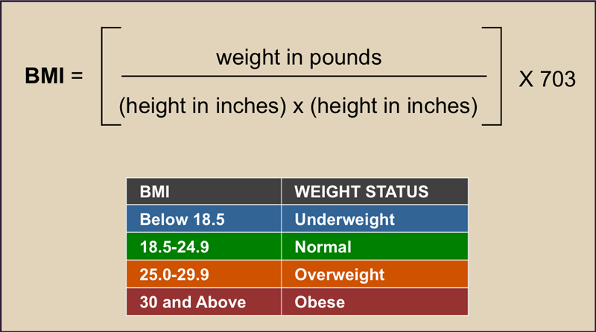
2 for 300
BMI formula
What is Body Mass Index a person's (weight in kilograms (kg) divided by his or her height in meters squared) or a person's (weight in pounds divided by his or her height in inches squared) times 703?

Slide 11
2 for 400
________ __________ is the ability to successfully control our emotions.
What is Emotion regulation?

Slide 12
2 for 500
Although facial expressions are pretty universal across the world, emotional _______ ______, in terms of how much emotion you should express, tend to vary greatly across cultures.
What are display rules?

Slide 13
3 for 100
_________ motivation: a person performs an action because the act is fun, challenging, or satisfying in an internal manner.
What is intrinsic?

Slide 14
3 for 200
The effect of the _____-_____ ___varies with the difficulty of the task.
What is the Yerkes-Dodson law?

Slide 15
3 for 300
______ ______ theory suggests that when we physically express the appearance of an emotion, such as a smile, we also tend to experience the cognitive emotion as well.
What is Facial feedback?

Slide 16
3 for 400
Which one of the following is not one of the six universally recognizable, basic emotions described by Ekman and his colleagues?
Surprise Fear
Disgust Anxiety
What is anxiety?
Psychological research has classified six facial expressions which correspond to distinct universal emotions: disgust, sadness, happiness, fear, anger, and surprise.

Slide 17
3 for 500
The __________ theory argues that we experience physiological arousal and emotion at the same time.
What is?

Slide 18
4 for 100
__________: the biologically determined and innate patterns of behavior that exist in both people and animals.
________ approach: approach to motivation that assumes people are governed by instincts similar to those of animals.
What are Instincts; Instinct?

Slide 19
4 for 200
__________ approaches are theories of motivation in which behavior is explained as a response to the external stimulus and its rewarding properties.
What is Incentive?

Slide 20
4 for 300
_______ is the experience of feeling or emotion. Components are emotion and motivation.
What is affect?

Slide 21
4 for 400
The statement We are afraid because we tremble is explained by this theory of emotion.
What is The James-Lange theory?

Slide 22
4 for 500
This theory has clearly been the most widely accepted theory of emotion.
What is Schachter-Singer theory?

Slide 23
5 for 100
_____-_________ theory: assumes behavior arises from physiological needs that cause internal drives to push the organism to satisfy the need and reduce tension and arousal.
What is Drive-reduction?

Slide 24
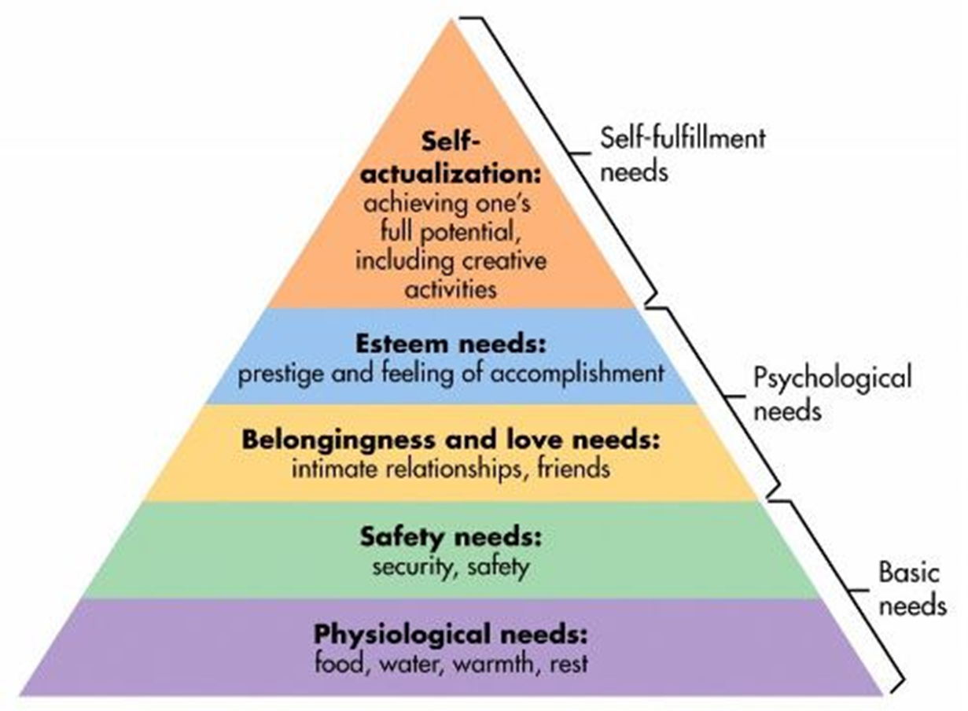
5 for 200
Maslow’s Hierarchy of Needs
What are
(the Drive-Reduction Theory of Motivation expanded)?

Slide 25
5 for 300
The part of the limbic system involved in regulating emotion
What is the amygdala?

Slide 26
5 for 400
According to the cognitive-mediational theory, proposed by ________, the stimulus leads to the personal meaning arrived at using cognition that leads to both the arousal and the emotion.
Who is Lazarus?

Slide 27
5 for 500
The two-factor theory of emotion was proposed by these two men.
Who are Schachter and Singer?

Slide 29
The End

