Slide 1
Development across the life span
?
Interactive Topic Test
rcg

Slide 2
1
2
3
4
5
100
100
100
100
100
200
200
200
200
200
300
300
300
300
300
400
400
400
400
400
500
500
500
500
500

Slide 3
1 for 100
______________ psychology is the scientific study of how and why human beings change over the course of their life. Originally concerned with infants and children, the field has expanded to include adolescence, adult development, aging, and the entire lifespan.
What is Developmental?

Slide 4
1 for 200
______-_________design: research design in which participants are first studied by means of a cross-sectional design but also followed and assessed over time.
What is Cross-sequential?

Slide 5
1 for 300
Phenylketonuria (also called ____) is a condition in which your body can't break down an amino acid called phenylalanine. Amino acids help build protein in your body. Without treatment, phenylalanine builds up in the blood and causes health problems.
What is PKU?

Slide 6
1 for 400
The terms _________and _________ describe the inheritance patterns of certain traits. That is, they describe how likely it is for a certain phenotype to pass from parent offspring.
What is dominant; recessive?

Slide 7
1 for 500
Dominant and recessive are the two types of genes. The main difference between dominant and recessive is, _________ gene expresses completely in the phenotype while _________ gene is not completely expressed in the phenotype.
What is dominant; recessive?

Slide 8
2 for 100
________ development is the name psychologists have given to the physical and cognitive changes that occur throughout a person's life.
What is Lifespan?

Slide 9
2 for 200
Your _________ is your complete heritable genetic identity, In contrast, _________ your is a description of your actual physical characteristics.
What is genotype; phenotype?

Slide 10
2 for 300
Piaget’s four stages of cognitive development.
What are: The sensorimotor stage, from birth to age 2. The preoperational stage, from age 2 to about age 7. The concrete operational stage, from age 7 to 11, The formal operational stage, which begins in adolescence and spans into adulthood?

Slide 11
2 for 400
Vygotsky’s __________ theory of human learning describes learning as a social process and the origination of human intelligence in society or culture. The major theme of Vygotsky’s theoretical framework is that social interaction plays a fundamental role in the development of cognition.
What is sociocultural?

Slide 12
2 for 500
__________ : process in which a more skilled learner gives help to a less skilled learner, then reduces the amount of help as the less skilled learner becomes more capable
What is Scaffolding?

Slide 13
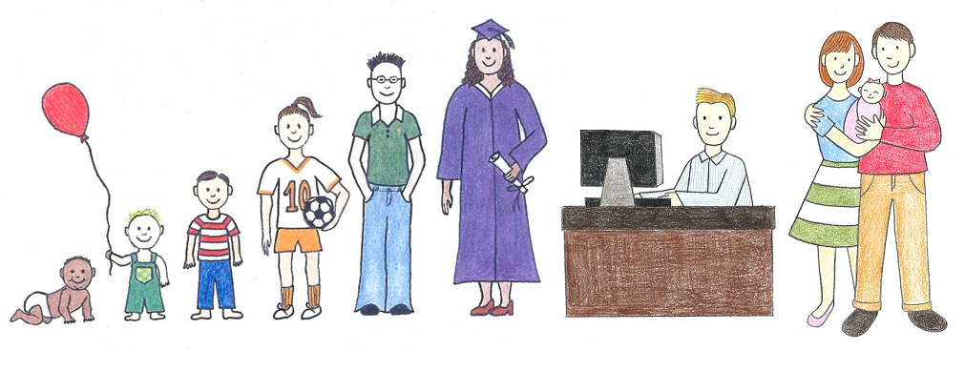
3 for 100
___________ design: research design in which one participant or group of participants is studied over a long period of time.
What is Longitudinal?

Slide 14
3 for 200
___________ twins: identical twins formed when one zygote splits into two separate masses of cells, each of which develops into a separate embryo.
What is Monozygotic?

Slide 15
3 for 300
____________ influences how a child behaves toward individuals and objects around them and how the environment affects them.
This concept also indicates that many behavioral tendencies are inborn – not the result of faulty parenting.
What is Temperament?

Slide 16
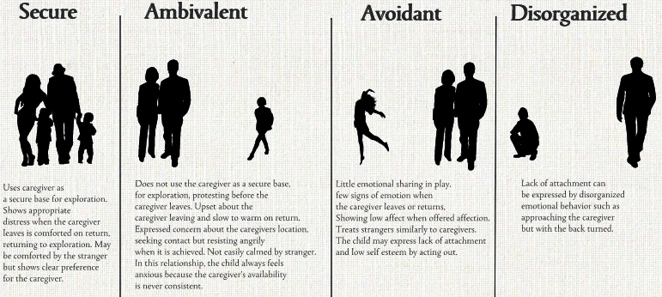
3 for 400
Secure, Ambivalent, Avoidant, & Disorganized
What are the patterns of attachment in children?

Slide 17
3 for 500
Erikson’s 8 Stages
What are trust vs. mistrust,
autonomy vs. shame/doubt,
initiative vs. guilt,
industry vs. inferiority,
identity vs. role confusion,
intimacy vs. isolation,
generativity vs. stagnation,
and integrity vs. despair?

Slide 18
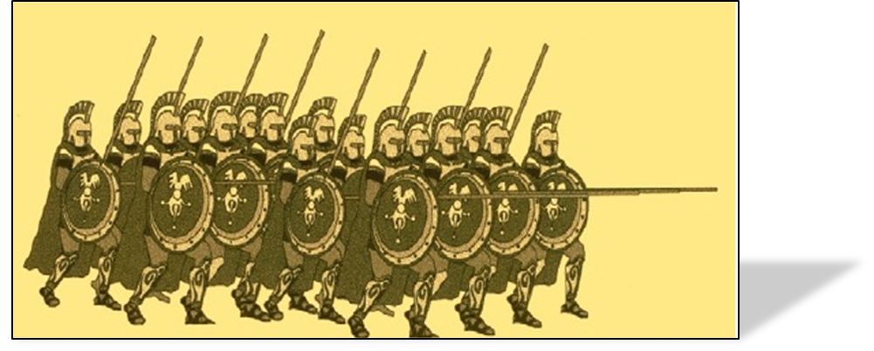
4 for 100
________ effect: impact on development when a group of people share a common time period or life experience.
What is a Cohort?

Slide 19
4 for 200
The three periods of prenatal development (not trimesters).
What are the germinal stage, the embryonic stage, and the fetal stage?

Slide 20
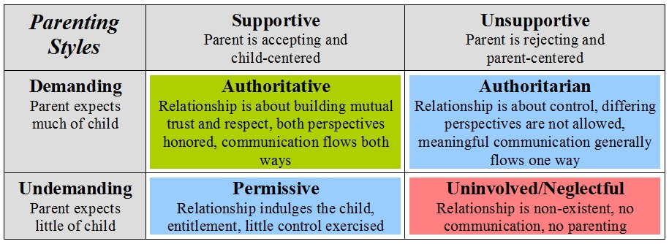
4 for 300
Three major parenting styles.
What are Authoritarian, Authoritative, and Permissive?

Slide 21
4 for 400
Kohlberg’s Levels of Morality
What are Preconventional morality: behavior is governed by the consequences of the behavior
Conventional morality: behavior is governed by conforming to society’s norms of behavior
Postconventional morality: behavior is governed by moral principles that have been decided on by the individual?

Slide 22
4 for 500
_________ thought refers to an inability to see a situation or event from another person's point of view. Although this is normal in children who are in Piaget’s pre-operational stage of thought (ages 2-7) it can affect individuals at any age. ________ thought creates a self-centered world view in which a person is unable to consider other people's feelings.
What is Egocentric?

Slide 23
5 for 100
____-_______ design: research design in which several different age groups of participants are studied at one particular point in time.
What is Cross-sectional?

Slide 24
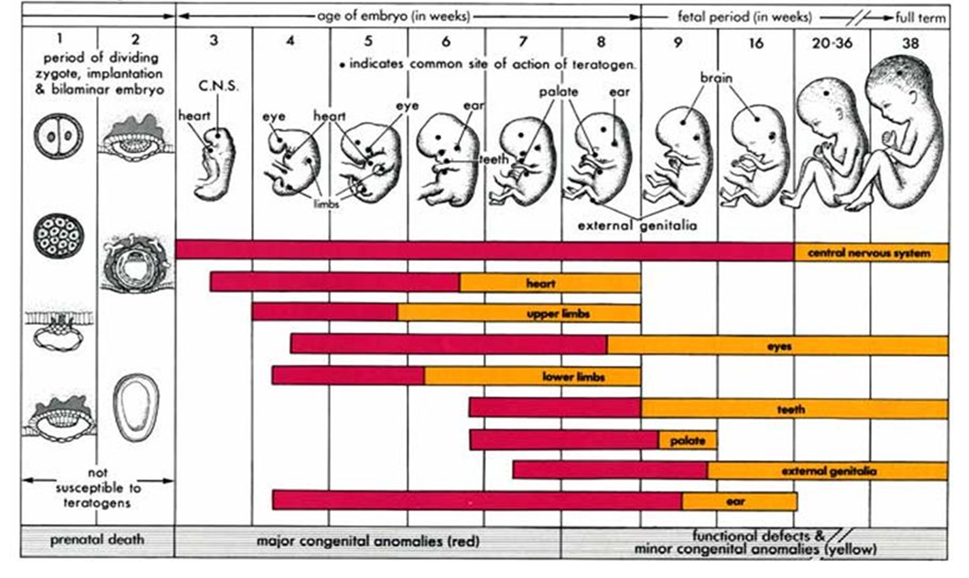
5 for 200
_________ : any factor that can cause a birth defect.
What is a Teratogen?

Slide 25
5 for 300
Three theories of aging.
What are
Cellular clock theory,
Wear-and-tear theory,
Free radical theory?

Slide 26
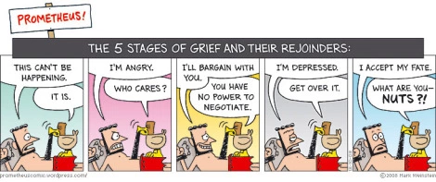
5 for 400
Kuble-Ross’s stages of dying.
What are denial, anger, bargaining, depression and acceptance?

Slide 27
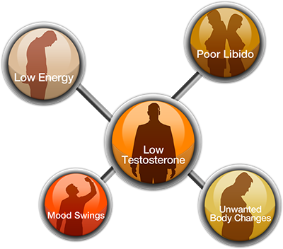
5 for 500
Women experience menopause, men experience ________.
What is andropause?

Slide 29
The End

