Slide 1
Cognitive Psychology
?
Interactive Topic Test
rcg

Slide 2
1
2
3
4
5
100
100
100
100
100
200
200
200
200
200
300
300
300
300
300
400
400
400
400
400
500
500
500
500
500

Slide 3
1 for 100
A _________ is an original or first model of something from which other forms are copied or developed.
What is a prototype?

Slide 4
1 for 200
The tendency to search for evidence that fits one’s beliefs while ignoring any evidence that does not fit those beliefs is known as __________ bias.
What is confirmation?

Slide 5
1 for 300
___________ thinking occurs when a problem is seen as having only one answer, & all lines of thinking will eventually lead to that single answer, using previous knowledge & logic.
What is Convergent?

Slide 6
1 for 400
_________ thinking occurs when a person starts from one point and comes up with many different ideas or possibilities based on that point (a kind of creativity).
What is divergent?

Slide 7
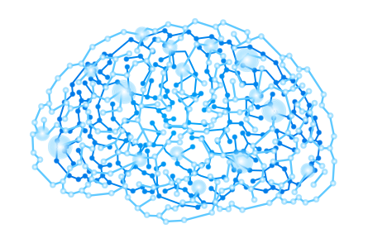
1 for 500
_________ is the ability to learn from one’s experiences, acquire knowledge, and use resources effectively in adapting to new situations or solving problems.
What is Intelligence?

Slide 8
2 for 100
An _________ is a very specific, step-by-step procedure for solving certain types of problems.
What is an algorithm?

Slide 9
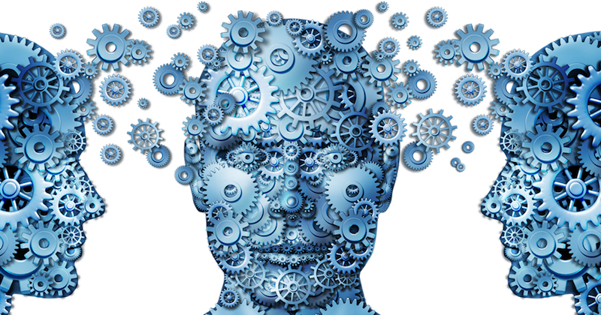
2 for 200
The two major types of intelligence.
What are intellectual and emotional?

Slide 10
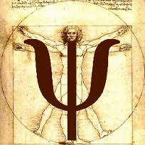
2 for 300
The two factors in spearman’s two factor theory.
What are G (general) and S (specific)?

Slide 11
2 for 400
Gardner’s nine multiple intelligences.
What are 1. Naturalist Intelligence (“Nature Smart”)
2. Musical Intelligence (“Musical Smart”)
3. Logical-Mathematical Intelligence (Number/Reasoning Smart)
4. Existential Intelligence (Philosophy Smart)
5. Interpersonal Intelligence (People Smart”)
6. Bodily-Kinesthetic Intelligence (“Body Smart”)
7. Linguistic Intelligence (Word Smart)
8. Intra-personal Intelligence (Self Smart”)
9. Spatial Intelligence (“Picture Smart”)?

Slide 12
2 for 500
The three kinds of intelligences purposed in Sternberg's triachic theory.
What are analytical, creative and practical?

Slide 13
3 for 100
A ________ is an educated guess based on prior experiences that helps narrow down the possible solutions for a problem; also known as a “rule of thumb”.
What is a heuristic?

Slide 14
3 for 200
A number representing a measure of intelligence.
What is intelligence quotient (IQ)?

Slide 15
3 for 300
The _________ IQ replaced the ratio IQ.
What is deviation?

Slide 16
3 for 400
__________ is the tendency of a test to produce the same scores again and again each time it is given to the same people.
_________ is the degree to which a test actually measures what it’s supposed to measure.
What is Reliability; Validity?

Slide 17
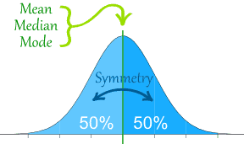
3 for 500
A _______distribution is a very important statistical data distribution pattern occurring in many natural phenomena, such as height, blood pressure, lengths of objects produced by machines, etc.
What is normal?

Slide 18
4 for 100
__________ _________ is a mental block to problem solving that comes from thinking about objects only in terms of their typical functions.
What is functional fixedness?

Slide 19
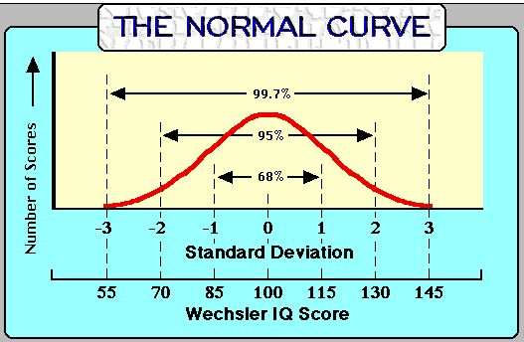
4 for 200
__________ IQ scores are a measure of intelligence that assumes that IQ is normally distributed around a mean of 100 with a standard deviation of about 15.
What is Deviation?

Slide 20
4 for 300
IQ tests are generally valid for predicting ________ _______and job performance.
What is academic success?

Slide 21
4 for 400
The ___________ of IQ is estimated at .5.
What is heritability?
Heritability is a statistic used in breeding and genetics works that estimates how much variation in a phenotypic trait in a population is due to genetic variation among individuals in that population. Other causes of measured variation in a trait are characterized as environmental factors, including measurement error..

Slide 22
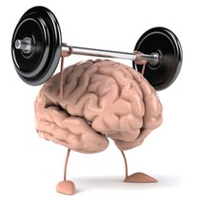
4 for 500
The _____ effect notes that IQ scores are steadily increasing over time in modernized countries.
What is Flynn?

Slide 23
5 for 100
The tendency for people to persist in using problem-solving patterns that have worked for them in the past describes a ______ ___.
What is mental set?

Slide 24
5 for 200
The 2 percent of the population falling on the upper end of the normal curve and typically possessing an IQ of 130 or above are _______.
What is gifted?

Slide 25
5 for 300
___________ ______ is a situational predicament in which people are or feel themselves to be at risk of conforming to stereotypes about their social group.
What is Stereotype threat?

Slide 26
5 for 400
To ______ is to analyze syntactically by assigning a constituent structure to (a sentence).
What is parse?

Slide 27
5 for 500
The theory that thought processes and concepts are controlled by language.
What is the Linguistic Relativity Hypothesis?

Slide 29
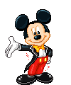
The End

