Slide 1

Memory
?
Interactive Topic Test
rcg

Slide 2
1
2
3
4
5
100
100
100
100
100
200
200
200
200
200
300
300
300
300
300
400
400
400
400
400
500
500
500
500
500

Slide 3

1 for 100
_______ is an active system that receives information from the senses, organizes and alters that information as it stores it away, and then retrieves the information from storage.
What is Memory?

Slide 4

1 for 200
Visual sensory memory, lasting only a fraction of a second is a.k.a. ______ memory
What is Iconic?

Slide 5

1 for 300
_____________ memory is a type of long-term memory including memory for skills, procedures, habits, and conditioned responses.
What is Nondeclarative or Implicit?

Slide 6
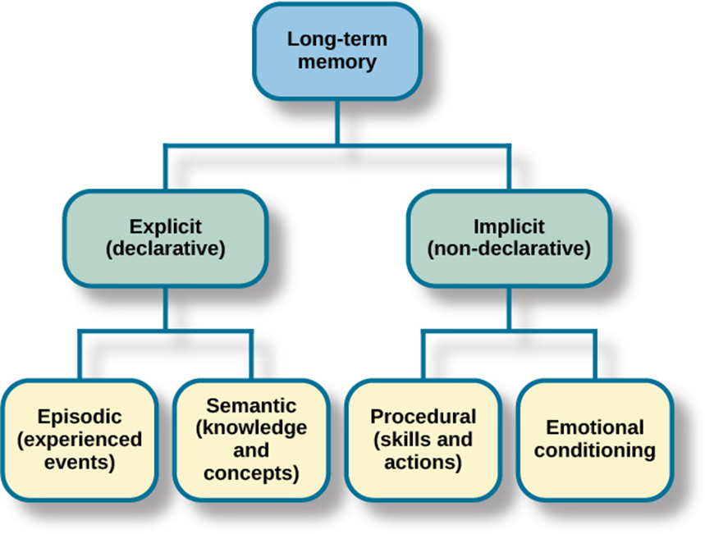
1 for 400
Two subsets of Nondeclarative (implicit) memory.
What are procedural and emotional?

Slide 7
1 for 500
Two subsets of Declarative (Explicit) memory.
What are episodic and somatic?

Slide 8
2 for 100
The ______-__-__________ model assumes that information that is more “deeply processed” or processed according to its meaning, rather than just the sound or physical characteristics of the word or words - will be remembered more efficiently and for a longer period of time.
What is levels-of-processing?

Slide 9

2 for 200
Audio sensory memory, lasting longer than iconic memory is a.k.a. ______ memory
What is echoic?

Slide 10

2 for 300
__________: Of or relating to meaning or the study of meaning.
What is Semantic?

Slide 11
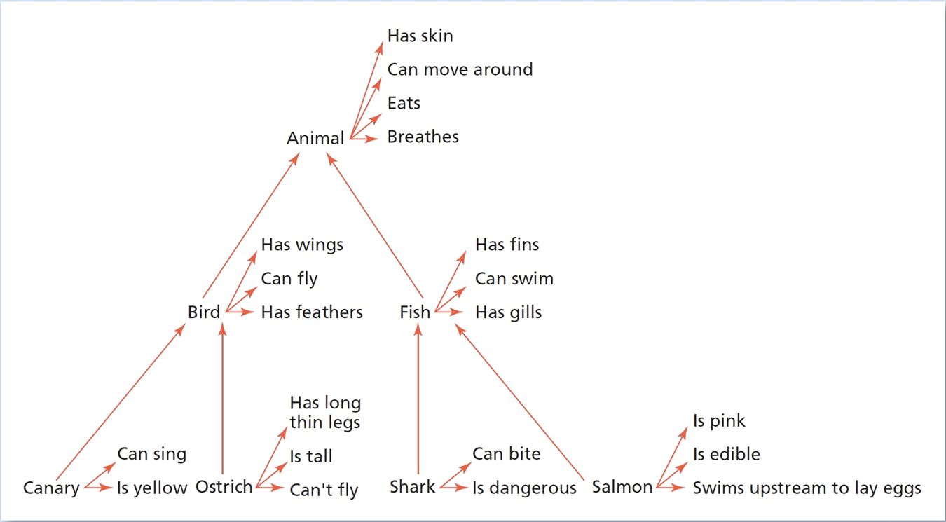

2 for 400
The __________ network model assumes that information is stored in the brain in a connected fashion.
What is semantic?
In the semantic network model of memory, concepts that are related in meaning are thought to be stored physically near each other in the brain. In this example, canary and ostrich are stored near the concept node for “bird,” whereas shark and salmon are stored near “fish.” But the fact that a canary is yellow is stored directly with that concept.

Slide 12
2 for 500
Encoding Specificity is _____-_________ learning: memories formed during a particular physiological or psychological (affective /emotional ) state will be easier to recall while in a similar state.
What is state-dependent?

Slide 13
3 for 100
The _____________-___________model assumes that the processing of information for memory storage is similar to the way a computer processes memory - in a series of three stages.
What is information-processing?

Slide 14
3 for 200
The traditional capacity of STM is about _______ items or pieces of information, plus or minus two items - or from five to nine bits of information.
What is seven?

Slide 15

3 for 300
When bits of information are combined into meaningful units,, so that more information can be held in STM its called _______.
What is chunking?

Slide 16
3 for 400
_____________ rehearsal: saying bits of information to be remembered over and over in one’s head in order to maintain it in short-term memory (STMs tend to be encoded in auditory form)
What is Maintenance?

Slide 17
3 for 500
__________ __________ is the tendency for memory of information to be improved if related information (e.g., surroundings or physiological state) available when the memory was first formed is also available when the memory is being retrieved.
What is Encoding specificity ?

Slide 18
4 for 100
The three stages of the Information-processing model of memory.
What are sensory register, short-term store, and long-term store.?

Slide 19
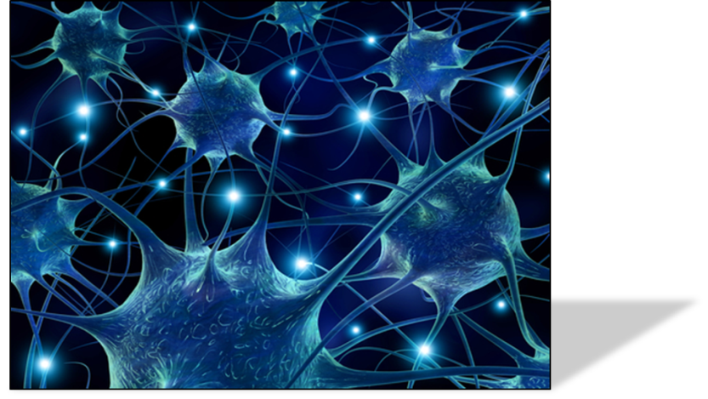
4 for 200
In the ________ _________ ___________ model, memory processes are proposed to take place at the same time over a large network of neural connections.
What is parallel distributed processing
or (PDP)?

Slide 20
4 for 300
Information-processing model
Information enters through the sensory system, briefly registering in sensory memory. Selective attention filters the information into short-term memory, where it is held while attention (rehearsal) continues. If the information receives enough rehearsal (maintenance or _____________), it will enter and be stored in long-term memory.
What is elaborative?

Slide 21
4 for 400
__________ _____: the tendency to falsely believe, through revision of older memories to include newer information, that one could have correctly predicted the outcome of an event.
What is Hindsight bias?

Slide 22
4 for 500
A memory retrieval process in which memories are “built,” or reconstructed, from information stored during encoding. It should be noted that with each retrieval, memories may be altered, revised, or influenced by newer information.
What is constructive processing?

Slide 23
5 for 100
___________is the set of mental operations that people perform on sensory information to convert that information into a form that is usable in the brain’s storage systems.
What is Encoding?

Slide 24

5 for 200
Short-term memory is a.k.a. _______ memory.
What is working?

Slide 25
5 for 300
STM lasts from about ________ to _______ seconds without rehearsal
What is twelve; thirty?

Slide 26
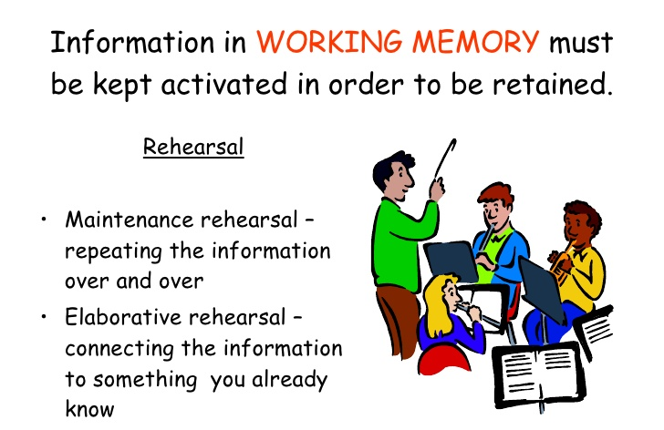
5 for 400
___________ rehearsal: a method of transferring information from STM into LTM by making that information meaningful in some way, as opposed to simply repeating the word to yourself over and over.
What is Elaborative?

Slide 27
5 for 500
__________ interference: memory retrieval problem that occurs when older information prevents or interferes with the retrieval of newer information
What is Proactive?

Slide 28
In the semantic network model of memory, concepts that are related in meaning are thought to be stored physically near each other in the brain. In this example, canary and ostrich are stored near the concept node for “bird,” whereas shark and salmon are stored near “fish.” But the fact that a canary is yellow is stored directly with that concept.
In the semantic network model of memory, concepts that are related in meaning are thought to be stored physically near each other in the brain. In this example, canary and ostrich are stored near the concept node for “bird,” whereas shark and salmon are stored near “fish.” But the fact that a canary is yellow is stored directly with that concept.

Slide 30








The End

