Slide 1
Learning
?
Interactive Topic Test
rcg

Slide 2
1
2
3
4
5
100
100
100
100
100
200
200
200
200
200
300
300
300
300
300
400
400
400
400
400
500
500
500
500
500

Slide 3
1 for 100
A learning process that occurs when two stimuli are repeatedly paired; a response that is at first elicited by the second stimulus is eventually elicited by the first stimulus alone.
What is classical conditioning (a.k.a. Pavlovian or respondent conditioning)?

Slide 4
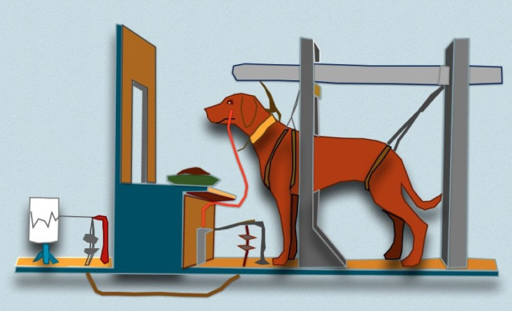
1 for 200
Russian physiologist who discovered classical conditioning through his work on digestion in dogs.
Who is Ivan Pavlov?

Slide 5
1 for 300
A naturally occurring stimulus that leads to an involuntary response.
What is an unconditioned stimulus (UCS)?
Note: unconditioned means “unlearned” or “naturally occurring.

Slide 6
1 for 400
____ must come before UCS. Backwards conditioning does not work!
____ and UCS must come very close together in time - ideally, only several seconds apart.
What is CS?

Slide 7
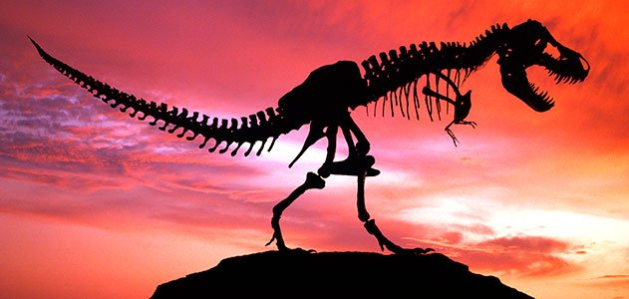
1 for 500
_________ is the disappearance or weakening of a learned response following the removal or absence of the unconditioned stimulus.
What is Extinction?

Slide 8
2 for 100
Any relatively permanent change in behavior brought about by experience or practice.
What is learning?

Slide 9
2 for 200
A stimulus that becomes able to produce a learned reflex response by being paired with the original unconditioned stimulus.
What is a conditioned stimulus (CS)?

Slide 10
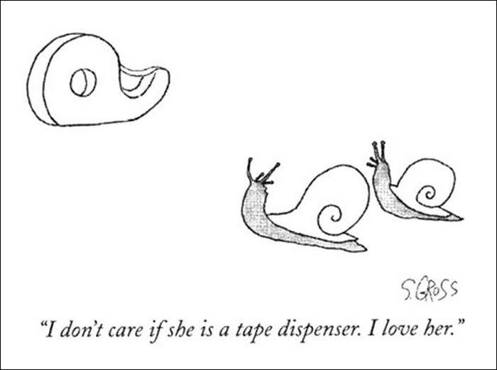
2 for 300
_______ _________ is the tendency to respond to a stimulus that is only similar to the original conditioned stimulus with the conditioned response,
What is Stimulus generalization?

Slide 11
2 for 400
___________ ________ is the term used to describe the reappearance of a learned response after extinction has occurred.
What is Spontaneous recovery?

Slide 12
2 for 500
An emotional response that has become classically conditioned to occur to learned stimuli.
What is a Conditioned Emotional Response (CER)?

Slide 13
3 for 100
_______ conditioning is the learning of voluntary behavior through the effects of pleasant and unpleasant consequences to responses.
What is Operant?

Slide 14
3 for 200
Operant conditioning (a.k.a. “____________ conditioning") is a type of learning in which (a) the strength of a behavior is modified by the behavior's consequences, such as reward or punishment, and (b) the behavior is controlled by antecedents called "discriminative stimuli" which come to signal those consequences
What is instrumental?

Slide 15
3 for 300
__________ reinforcer: any reinforcer that becomes reinforcing after being paired with a primary reinforcer, such as praise, tokens, or gold stars.
What is secondary?

Slide 16
3 for 400
The _______ _______ effect describes a response that is reinforced after some - but not all - correct responses and tends to be very resistant to extinction.
What is partial reinforcement?

Slide 17
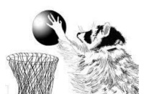
3 for 500
_________ _____: tendency for an animal’s behavior to revert to genetically controlled patterns.
What is Instinctive drift?

Slide 18
4 for 100
_____________ was one of the most influential of American psychologists. A behaviorist, he developed the theory of operant conditioning -- the idea that behavior is determined by its consequences, be they reinforcements or punishments, which make it more or less likely that the behavior will occur again. Skinner believed that the only scientific approach to psychology was one that studied behaviors, not internal (subjective) mental processes.
Who is B. F. Skinner?

Slide 19
4 for 200
_________ reinforcer: any reinforcer that is naturally reinforcing by meeting a basic biological need, such as hunger, thirst, or touch
What is Primary?

Slide 20
4 for 300
________reinforcement: the reinforcement of a response by the removal, escape from, or avoidance of an unpleasant stimulus.
What is Negative ?

Slide 21
4 for 400
_______ ________ ________ : modern term for a form of behavior modification that uses shaping techniques to mold a desired behavior or response.
What is Applied behavior analysis (ABA)?

Slide 22
4 for 500
______ learning: learning that remains hidden until its application becomes useful.
What is Latent?

Slide 23
5 for 100
Learning new behavior by watching a model perform that behavior it is a type of learning most associated with the work and social learning theory of psychologist _______ ________.
Who is Albert Bandura?

Slide 24
5 for 200
Four Elements of Observational Learning
What are attention, memory, imitation and motivation?

Slide 25
5 for 300
Observational learning (aka, Social Learning) suggests that individuals learn by
______________.
What is modeling?

Slide 26
5 for 400
Observation of violence is linked to a ________ likelihood of subsequently acting aggressively.
What is greater?

Slide 27
5 for 500
What is a bobo doll?

Slide 29
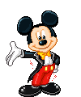
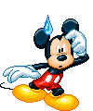
The End

