Slide 1
The Science of Psychology
?
Interactive Topic Test
rcg

Slide 2
1
2
3
4
5
100
100
100
100
100
200
200
200
200
200
300
300
300
300
300
400
400
400
400
400
500
500
500
500
500

Slide 3
1 for 100
___________ is the scientific study of behavior and mental processes.
What is Psychology?

Slide 4
1 for 200
The four goals of Psychology.
What are describe, explain, predict and control?

Slide 5
1 for 300
_______________as a school of psychology seeks to analyze the adult mind in terms of the simplest definable components and then to find how these components fit together to form more complex experiences as well as how they correlated to physical events. To do this, psychologists employ introspection, self-reports of sensations, views, feelings, emotions, etc.
What is Structuralism?

Slide 6
1 for 400
________________ is a study of consciousness developed by William James. This psychological philosophy considers mental life and behavior in terms of active adaptation to the person's environment.
What is Functionalism?

Slide 7
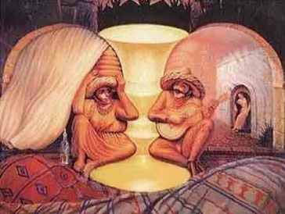
1 for 500
__________ psychology is an attempt to understand the laws behind the ability to acquire and maintain meaningful perceptions in an apparently chaotic world.
What is Gestalt?

Slide 8
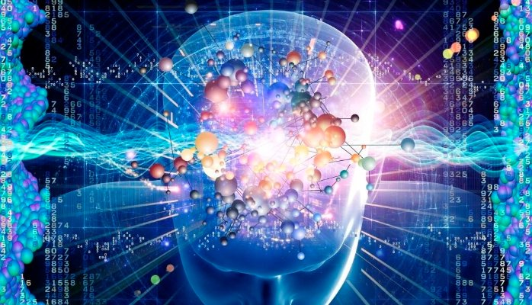
2 for 100
__________ psychology: field focusing not only on perception but also on learning, memory, thought processes, and problem solving.
What is Cognitive?

Slide 9
2 for 200
__________ theory is the theory of personality organization and the dynamics of personality development that guides psychoanalysis, a clinical method for treating psychopathology. First laid out by Sigmund Freud in the late 19th century, psychoanalytic theory has undergone many refinements since his work.
What is Psychoanalytic?

Slide 10
2 for 300
____________ is a worldview that assumes a learner is essentially passive, responding to environmental stimuli. The learner starts off as a clean slate (i.e. tabula rasa) and behavior is shaped through positive reinforcement or negative reinforcement.
What is Behaviorism?

Slide 11
2 for 400
Steps in the scientific method (per your text).
What are
Perceive the question
Form a hypothesis
Test the hypothesis
Draw conclusions
Report your results?

Slide 12
2 for 500
7 major modern psychological perspectives.
What are
The Psychodynamic Perspective. ...
The Behavioral Perspective. ...
The Cognitive Perspective. ...
The Biopsychological Perspective. ...
The Sociocultural Perspective. ...
The Evolutionary Perspective. ...
The Humanistic Perspective?

Slide 13
3 for 100
__________ is a statistical technique that can show whether and how strongly pairs of variables are related.
What is Correlation?

Slide 14
3 for 200
__________does not prove causation!
What is Correlation?

Slide 15
3 for 300
Positive 1 or negative 1.
What is a prefect correlation coefficient ?

Slide 16
3 for 400
An ___________ is a procedure carried out to verify, refute, or validate a hypothesis. Experiments provide insight into cause-and-effect by demonstrating what outcome occurs when a particular factor is manipulated.
What is an experiment?

Slide 17
3 for 500
The variable in an experiment that is manipulated by the experimenter.
What is an independent variable (IV)?

Slide 18
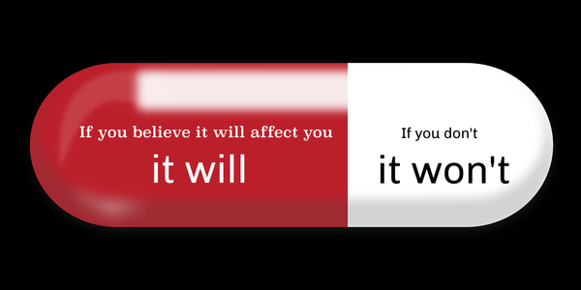
4 for 100
The phenomenon in which the expectations of the participants in a study can influence their behavior.
What is the Placebo effect?

Slide 19
4 for 200
A _________study is one in which neither the participants nor the experimenters know who is receiving a particular treatment. This procedure is utilized to prevent bias in research results.
What is a double-blind study ?

Slide 20
4 for 300
That the rights and well-being of participants in an experiment must be weighed against the study’s value to science is a common _______ guideline.
What is ethical?

Slide 21
4 for 400
_______ ______is the ability to make reasoned judgments about claims.
What is Critical thinking ?

Slide 22
4 for 500
The __________ perspective on psychology focuses on the biological bases of universal mental characteristics that all humans share. It looks at the way the mind works and why it works as it does. From this perspective behavior is seen as having an adaptive or survival value.
What is evolutionary?

Slide 23
5 for 100
A _________ is a medical doctor who has specialized in the diagnosis and treatment of psychological disorders
Who is a Psychiatrist ?

Slide 24
5 for 200
Functionalism (how the mind allows people to adapt, live, work, and play) was proposed by William ______.
Who is James?

Slide 25
5 for 300
____________ is the process of objectively examining and measuring one’s thoughts and mental activities.
What is Introspection?

Slide 26
5 for 400
The study of one individual in great detail is called a _______ study.
What is case?

Slide 27
5 for 500
If you are sick and are part of an experiment seeking to validate a cure it’s best to be in the _________ group.
What is experimental?

Slide 29
The End

