Slide 1
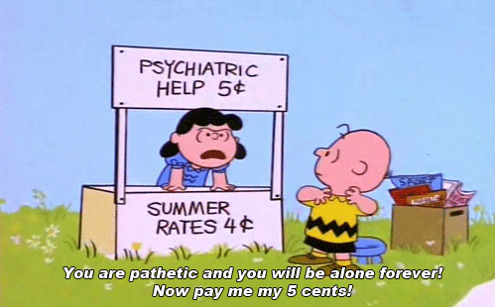

Psychological Therapies
?
Interactive Topic Test
rcg

Slide 2
1
2
3
4
5
100
100
100
100
100
200
200
200
200
200
300
300
300
300
300
400
400
400
400
400
500
500
500
500
500

Slide 3

1 for 100
The two broad categories of therapy.
What are (1) psychological theory / techniques (Psychotherapy) and (2) medical intervention (Biomedical )?

Slide 4
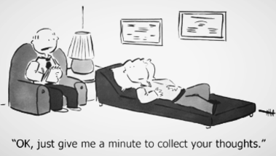
1 for 200
The two broad categories of Psychotherapy.
What are insight (therapies involved in understanding ones' motives)
and action (a therapy that is directed more at changing behavior than providing insights into reasons for that behavior) therapies?

Slide 5
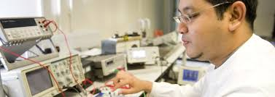
1 for 300
Medical treatments such as drug therapy, electroconvulsive therapy (electroshock), or surgery (i.e. lobotomy) are examples of ___________ therapy.
What is biomedical?

Slide 6

1 for 400
Psychoanalysis is _______therapy based on the theory of Freud, emphasizing the revealing of unconscious conflicts.
What is insight?

Slide 7

1 for 500
________content is the actual content of one’s dream; while, ________ content is the symbolic or hidden meaning of dreams.
What are Manifest; latent?

Slide 8

2 for 100
Psychoanalysis today is generally ________ as it actively gives interpretations of a client’s statements in therapy, even suggesting certain behavior or actions.
What is directive?

Slide 9
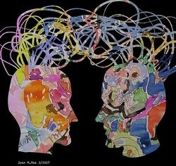
2 for 200
IPT
What is Interpersonal therapy?
IPT is a form of therapy for depression which incorporates multiple approaches and focuses on interpersonal problems.

Slide 10
2 for 300
_______ therapy is an existential/experiential form of psychotherapy that emphasizes personal responsibility, and that focuses upon the individual's experience in the present moment, the therapist–client relationship, the environmental and social contexts of a person's life, and the self-regulating adjustments people make as a result of their overall situation....
What is Gestalt?

Slide 11
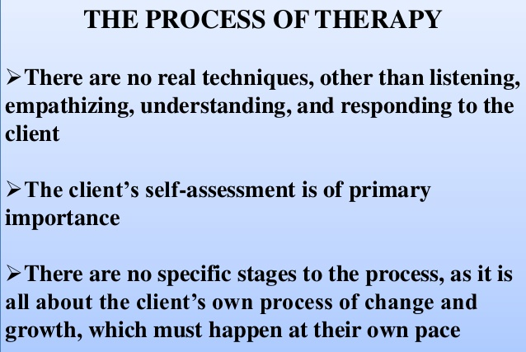
2 for 400
Rogers’s P_______- C_______ therapy is a nondirective insight therapy in which the client does all the talking and the therapist listens.
What is Person-Centered?

Slide 12
2 for 500
The four elements of Rogers’s Person-Centered Therapy
What are authenticity: the genuine, open, and honest response of the therapist to the client
unconditional positive regard: the warmth, respect, and accepting atmosphere created by the therapist for the client in person-centered therapy
empathy: the ability of the therapist to understand the feelings of the client
reflection: the therapist restates what the client says rather than interpreting those statements?

Slide 13

3 for 100
MI
What is Motivational interviewing , in contrast to client-centered (person-centered) therapy, MI has specific goals: namely, to reduce ambivalence about change and to increase intrinsic motivation to bring that change about?

Slide 14
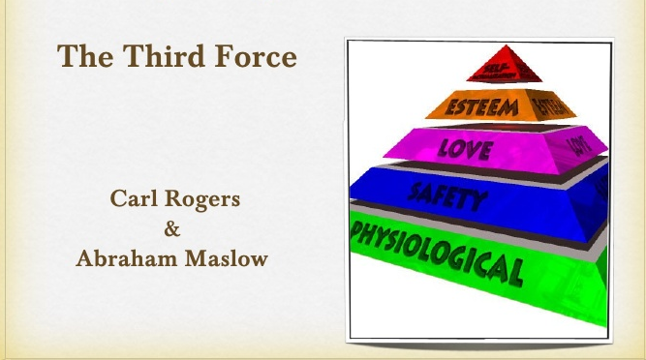
3 for 200
____________therapies are not based in experimental research and work best with intelligent, highly verbal persons.
What is Humanistic?

Slide 15

3 for 300
Behavior therapies are _______therapies based on the principles of classical & operant conditioning & aimed at changing disordered behavior without concern for the original causes of such behavior
What is action?

Slide 16
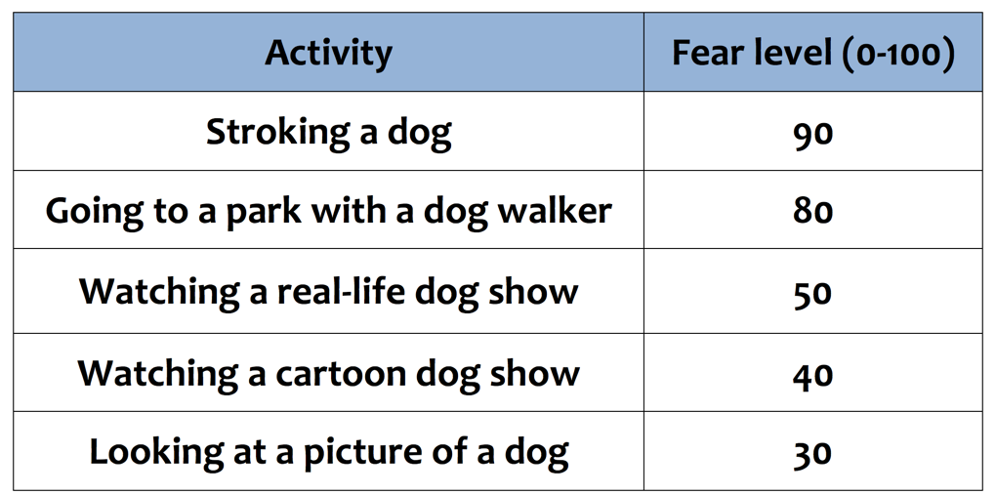
3 for 400
_________ _________ is a behavioral technique used to treat phobias, in which a client is asked to make a list of ordered fears and taught to relax while concentrating on those fears.
What is Systematic desensitization?

Slide 17

3 for 500
________ is a technique for treating phobias and other stress disorders in which the person is rapidly and intensely exposed to the fear-provoking situation or object and prevented from making the usual avoidance or escape response.
What is Flooding?

Slide 18
4 for 100
EMDR
What is eye-movement desensitization reprocessing (EMDR) a controversial therapy for posttraumatic stress disorder and similar anxiety problems in which the client is directed to move the eyes rapidly back and forth while thinking of a disturbing memory?

Slide 19

4 for 200
_______therapy is a therapy in which the focus is on helping clients recognize distortions in their thinking and replace distorted, unrealistic beliefs with more realistic, helpful thoughts.
What is Cognitive?

Slide 20
4 for 300
A therapist who tries to decrease incongruence in the client is likely to have a/an __________ approach
What is humanistic (Carl Rogers introduced the concept of incongruence to psychology in the 1950s. Although general use of the word has come to mean inconsistent or incompatible, Rogers had a more specific definition in mind. He defined congruence as the matching of experience and awareness)?

Slide 21
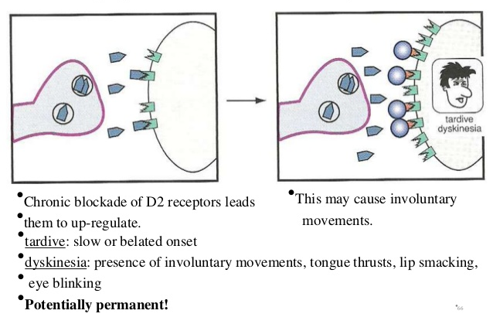
4 for 400
This treatment produces the serious side effect known as tardive dyskinesia.
What are typical antipsychotic drugs?

Slide 22
4 for 500
Five Cognitive distortions.
What are arbitrary inference
selective thinking
overgeneralization
magnification and minimization
personalization?

Slide 23
5 for 100
Group therapy is most useful to persons who cannot afford individual therapy and/or those that may obtain a great deal of social and emotional support from other group members.
What is true?

Slide 24
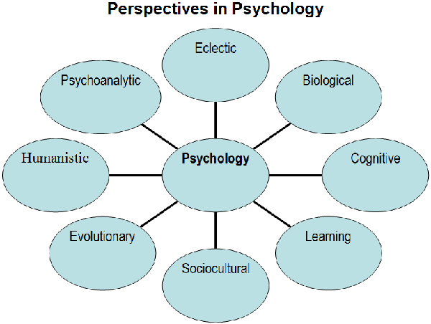
5 for 200
______ therapies are a type of therapy that results from combining elements of several different therapy techniques.
What is Eclectic?

Slide 25
5 for 300
Three goals of Cognitive-Behavioral Therapies
What are Relieve the symptoms and solve the problems,
Help develop strategies for solving future problems,
Help change irrational, distorted thinking?

Slide 26
5 for 400
The most commonly prescribed class of antidepressants.
What are the SSRIs (selective serotonin reuptake inhibitors)? They act on a chemical in the brain called serotonin. The SSRIs include drugs such as Prozac, Zoloft, and Paxil. SSRIs are not atypical antidepressants.

Slide 27
5 for 500
________-________ therapy is a therapy in which clients are directly challenged in their irrational beliefs and helped to restructure their thinking into more rational belief statements
What is cognitive-behavioral?

Slide 28
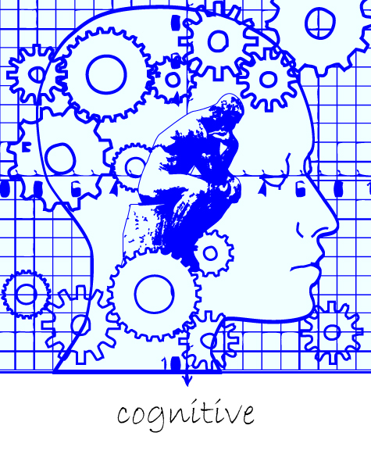

Slide 29






The End

