Slide 1
Social Psychology
?
Interactive Topic Test
rcg

Slide 2
1
2
3
4
5
100
100
100
100
100
200
200
200
200
200
300
300
300
300
300
400
400
400
400
400
500
500
500
500
500

Slide 3
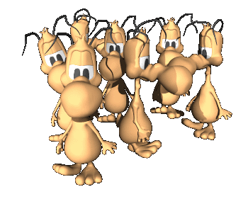
1 for 100
_____ _________is the scientific study of how people's thoughts, feelings, and behaviors are influenced by the actual, imagined, or implied presence of others.
What is Social psychology?

Slide 4
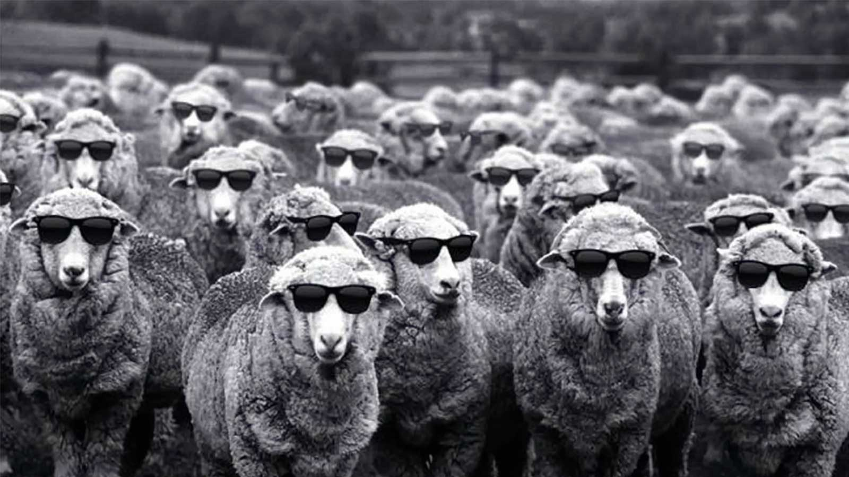
1 for 200
_________ is the changing of one’s own behavior to match that of other people.
What is Conformity?

Slide 5
1 for 300
Changing one’s behavior as a result of other people directing or asking for the change is called ________.
What is Compliance?

Slide 6
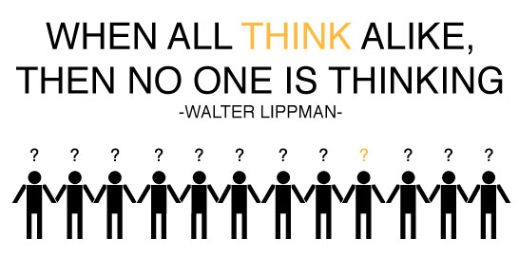
1 for 400
_________occurs when people place more importance on maintaining group cohesiveness than on assessing the facts of the problem with which the group is concerned.
What is Groupthink?

Slide 7
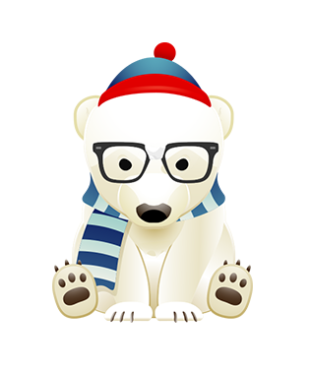
1 for 500
When members involved in a group discussion take somewhat more extreme positions and suggest riskier actions than do individuals who have not participated in a group discussion, group ___________ has occurred.
What is polarization?

Slide 8
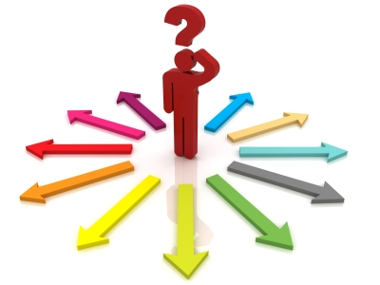
2 for 100
The opposite of social impairment (negative influence of others on performance) is social ________ (positive influence of others on performance).
What is facilitation?

Slide 9
2 for 200
The phenomenon of a person exerting less effort to achieve a goal when they work in a group than when they work alone is known as _____ ________.
What is social loafing ?

Slide 10
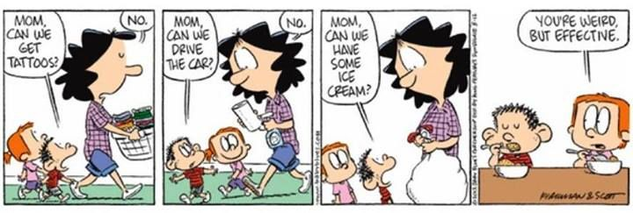
2 for 300
Asking for a large commitment and then, after being refused, asking for a smaller commitment is known as the ______________ technique.
What is Door-in-the-face?

Slide 11
2 for 400
___________ is changing one’s behavior at the command of an authority figure.
What is Obedience?

Slide 12
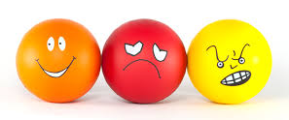
2 for 500
The three components of an attitude.
What are
the affective (emotional) component
the behavioral component
the cognitive component?

Slide 13
3 for 100
Attitudes are often ______ predictors of behavior unless the attitude is very specific or very strong.
What is poor?

Slide 14
3 for 200 Elaboration Likelihood Model of Persuasion
__________ processing involves attending to the content of the message itself – greater long term effectiveness.
What is Central-route?

Slide 15
3 for 300 Elaboration Likelihood Model of Persuasion
_________ processing: involves attending to factors not involved in the message, such as the expertise of the source of the message, the length of the message, and other non-content factors.
What is Peripheral-route?

Slide 16
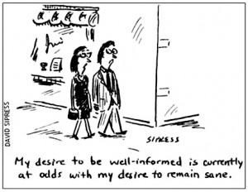
3 for 400
The sense of discomfort or distress that occurs when a person’s behavior does not correspond to that person’s impression is called _______ __________.
What is cognitive dissonance?

Slide 17
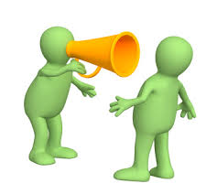
3 for 500
Four key elements in persuasion.
What are the source of the message, the message itself, the target audience, and the medium?

Slide 18
4 for 100
A _________ is a set of characteristics that people believe is shared by all members of a particular social category.
What is a stereotype?

Slide 19
4 for 200
The tendency to overestimate the influence of internal factors in determining behavior while underestimating situational factors is called ___________________________.
What is
The Fundamental attribution error or actor-observer bias?

Slide 20
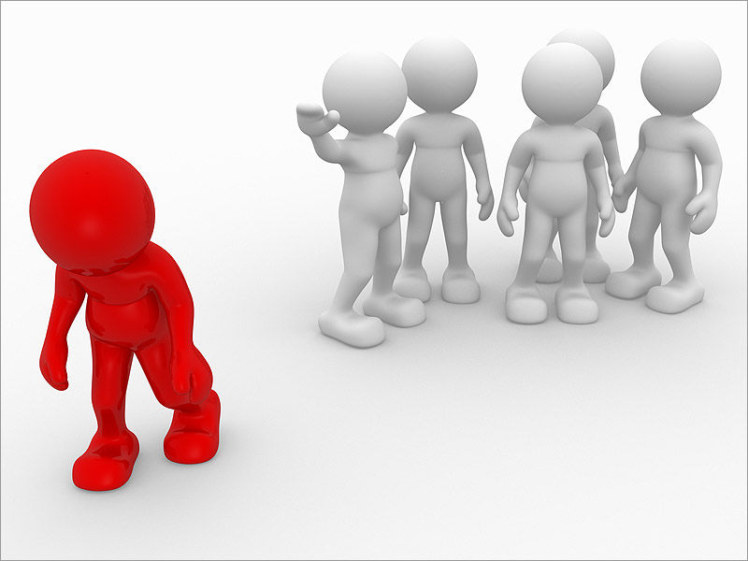
4 for 300
_______ is a negative attitude held by a person about the members of a particular social group, while ________ is the act of treating people differently because of the social group to which they belong.
What are Prejudice; Discrimination?

Slide 21
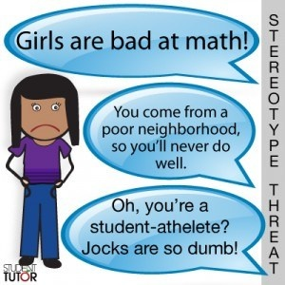
4 for 400
The effect that people’s awareness of the stereotypes associated with their social group has on their behavior is called stereotype ___________.
What is vulnerability?

Slide 22
4 for 500
The tendency of one’s expectations to affect one’s behavior in such a way as to make the expectation more likely to occur is known as a self-fulfilling _________.
What is prophecy?

Slide 23
5 for 100
Sternberg’s three components of love.
What are
intimacy
passion
commitment?

Slide 24
5 for 200
Prosocial behavior that is done with no expectation of reward and may involve the risk of harm to oneself is called ________.
What is Altruism?

Slide 25
5 for 300
The ________ effect acknowledges that the presence of other people affects the decision of a person to help or not help someone in trouble.
What is bystander?

Slide 26
5 for 400
Five steps in making a decision to help.
What are
noticing
defining an emergency
taking responsibility
planning a course of action
taking action?

Slide 27
5 for 500
Four Factors in Interpersonal attraction.
What are
physical attractiveness
proximity: physical or geographical nearness
people like people who are similar to themselves OR who are different from themselves (complementary)
reciprocity of liking?

Slide 29
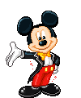
The End

