Slide 1
Sexuality and Gender
?
Interactive Topic Test
rcg

Slide 2
1
2
3
4
5
100
100
100
100
100
200
200
200
200
200
300
300
300
300
300
400
400
400
400
400
500
500
500
500
500

Slide 3
1 for 100
________ is the range of characteristics pertaining to, and differentiating between, masculinity and femininity.
What is Gender?

Slide 4
1 for 200
_________ sex characteristics are structures that are present at birth and any of the body structures directly concerned in reproduction.
What is Primary?

Slide 5
1 for 300
____________ sex characteristics are sexual organs and traits that develop at puberty and are indirectly involved in human reproduction.
What is Secondary?

Slide 6
1 for 400
__________ is the capacity of humans to have erotic experiences and responses.
What is Sexuality?

Slide 7
1 for 500
__________ are female sex hormones.
__________ are male sex hormones.
What are Estrogens; Androgens?

Slide 8
2 for 100
Hormones, chromosomes, and evolutionary selection are _________ influences on gender.
What is biological?

Slide 9
2 for 200
Gender _______ make up the culture’s expectations for masculine or feminine behavior and include attitudes, actions, and personality traits
What are roles?

Slide 10
2 for 300
Gender ______theory: a child develops a mental pattern for being male or female and then organizes observed and learned behavior around that mental pattern.
What is schema?

Slide 11
2 for 400
______ _______ theory proposes that gender identity is formed through reinforcement of appropriate gender behavior as well as imitation of gender models.
What is Social learning?

Slide 12
2 for 500
A person is said to be ___________ when their sense of gender identity does not match their external experience or chromosomes.
What is transgendered?

Slide 13
3 for 100
___________ : a concept held about a person or group of people that is based on superficial, irrelevant characteristics.
A gender __________ is a concept held about a person or group of people that is based on their being male or female.
What is Stereotype; stereotype?

Slide 14
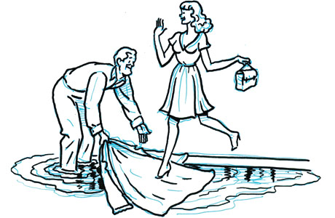
3 for 200
_________ sexism is the acceptance of positive stereotypes of males and females that leads to unequal treatment.
What is Benevolent?

Slide 15
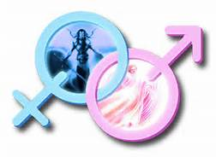
3 for 300
__________ is characteristic of possessing the most positive personality characteristics of males and females regardless of actual sex
What is Androgyny?

Slide 16
3 for 400
Four stages of human sexual response.
What are excitement, plateau, orgasm, and resolution?

Slide 17
3 for 500
Three major sex studies.
What are Masters and Johnson, Kinsey Studies, and the Janus Report?

Slide 18
4 for 100
Sexual __________ is a person’s sexual attraction preference for members of a particular sex.
What is orientation?

Slide 19
4 for 200
___________ : attracted to the opposite sex
___________ : attracted to the same sex
___________ : attracted to both men & women
What is
heterosexual;
homosexual;
bisexual?

Slide 20
4 for 300
______ is a sexually transmitted viral disorder that causes deterioration of the immune system and eventually results in death due to complicating infections that the body can no longer fight.
What is Aids?

Slide 21
4 for 400
Two types of STIs.
What are bacterial and viral?

Slide 22
4 for 500
Common _________STIs are chlamydia, syphilis, and gonorrhea which are treatable with antibiotics
What is bacterial?

Slide 23
5 for 100
_______ __________ are a heterogeneous group of disorders that are typically characterized by a clinically significant disturbance in a person’s ability to respond sexually or to experience sexual pleasure.
What are Sexual dysfunctions?

Slide 24
5 for 200
STI
What are Sexually transmitted infections?

Slide 25
5 for 300
For most people, biological sex, gender identity, and gender role ________.
What is agree?

Slide 26
5 for 400
A woman wears perfume, a soft hair style, and make-up. These feminine characteristics are determined by ________.
What is culture?

Slide 27
5 for 500
Robert is decisive, nurturing, aggressive, and compassionate. Given these characteristics, Robert might be referred to as __________.
What is androgynous?

Slide 29
The End

